Slide 1


Sensors for Driving Direction and Turning Angle
eCompass module:
3D accelerometer and 3D magnetometer
Caution: Steering sensor input is not necessarily the real angle of the vehicle, “skipping” may occur
Use LSM303 or equivalent to sense the direction of the vehicle
Actual trajectory
Angular error
Reference trajectory
Angular error
Lateral error
The LSM303DLHC includes an I 2 C serial bus
interface that supports standard and fast mode
100 kHz and 400 kHz. The system can be
configured to generate interrupt signals by inertial
wake-up/free-fall events as well as by the position
of the device itself.
Reference trajectory
Use
Actual trajectory
Harry Li, Ph.D. April 2015

Slide 2
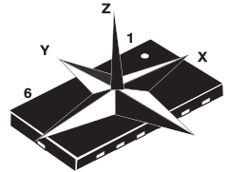
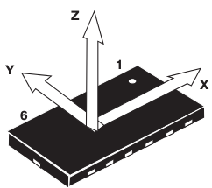


3D Accelerometer and
3D Magnetomete LMS303
3D magnetometer
3D accelerometer
Table 9
I2C Interface
(1) The transaction started through a START (ST) signal, defined as a high-to-low on the data line while the SCL line is held high.
(2) After ST, the next byte contains the slave address (the first 7 bit), bit 8 for if the master is receiving or transmitting data.
(3) When an address sent, each device compares the first seven bits after ST. If they match, the device is addressed.
Reference: Table 9, pp 19, from LSM303 datasheet
Harry Li, Ph.D. April 2015

Slide 3
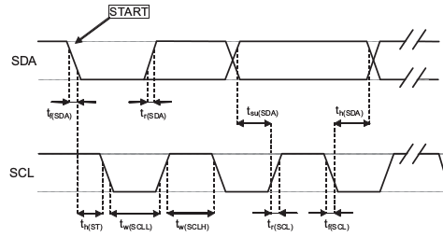
I2C Handshaking LMS303
Table 11. Transfer when master is writing one byte to slave, pp 20, datasheet
Master
ST
Slave
SAD+W
SAK
SUB
SAK
Figure 3. I 2 C slave timing diagram, pp 13 from datasheet
Harry Li, Ph.D. April 2015

Slide 4
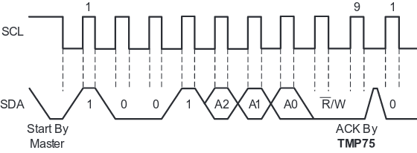
I2C Waveform Reference
Since LSM303 sensor datasheet did not provide the detailed waveform, we are using ti i2c temperature sensor as an example. The i2c waveform should be common to both devices
Starting the next frame
Total 8 bits of data from the master
The SAK slave acknowledges the 8 bits of data from the master
ST by master, e.g., sda goes low while scl holds high
http://www.ti.com/lit/ds/symlink/tmp175.pdf
Harry Li, Ph.D. April 2015

Slide 5
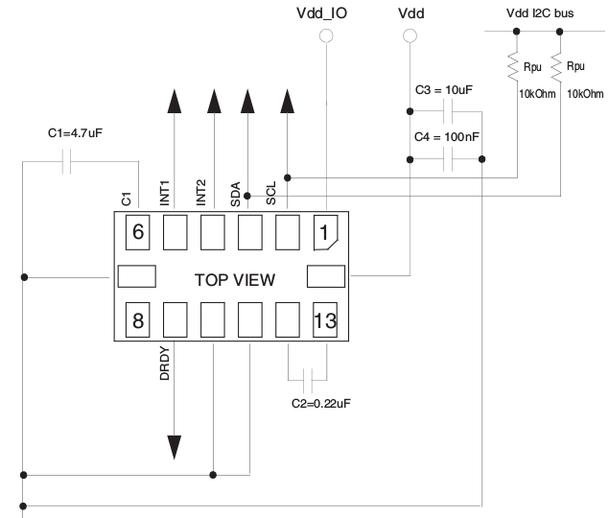
3D Accelerometer/Magnetomete Wire Diagram
pp. 17, figure 4 from datasheet
Pull up resistors
GND
Harry Li, Ph.D. April 2015

Slide 6
I2C Sensor Init and Config
Table 11. Transfer when master is writing one byte to slave, pp 20, datasheet
Table 12. Transfer when master is writing multiple bytes to slave, pp 20
1. Perform init and config by identify the i2c device (device address, from datasheet
2. identify the right sensor block with the sub-address, from datasheet
3. identify the control register(s) responsible for the init and config operations from datasheet
Harry Li, Ph.D. April 2015

Slide 7
Steps for Init and Config (1)
1
2
1. Perform init and config by identify the i2c device (device address, from datasheet 0x3c, pp. 21)
Master
ST
SAD+W= 0x3c
SAK
For magnetic sensors the default (factory) 7-bit slave address is 0011110xb. The x bit is 0 for read and 1 for write
SUB = 0x00
SAK
2. identify control register(s) for the right sensor block with the sub-address to set data rate
(1) CRA_REG_M register ( 0x00) to set data rate
Example; 3.0 Hz data rate, so 1 0 0 0 1 0 0 0
DO2-DO1-DO0 = 0 1 0
0x88, so write 0x88 to 0x00 location (CRA_REG_M)
Harry Li, Ph.D. Mar 2017

Slide 8
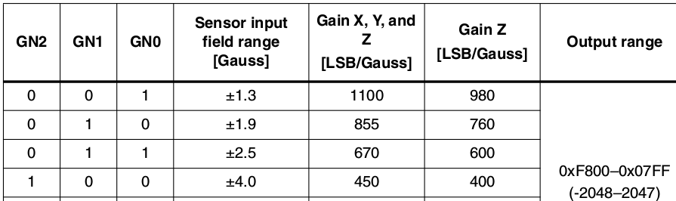
Steps for Init and Config (2)
1
2
3
Note; set smaller gain for stronger Gauss, adaptation algorithm may be needed
3. identify the control register(s) responsible for gain setting, from datasheet, pp 37, table 73, 75
Identify the control register CRB_REG_M (01h) for gain settings
Harry Li, Ph.D. Mar 2017

Slide 9
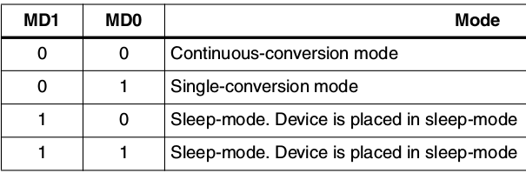
Steps for Init and Config (3)
1
2
3
4
4. identify the control register responsible for mode of operation, from datasheet, pp 37, table 76, 78
MR_REG_M (02h)
Master
Slave
SUB = 0x02
SAK
SUB = 0x00
SAK
Select continuous conversion mode, so set the register to 00, e.g., write 0x00 to address 0x02
Harry Li, Ph.D. Mar 2017

Slide 10

Read the Sensor Data
Repeated start
Master Acknowledgment
No Master Acknowledgment
5. Identify the data register(s) to read sensor data back to a buffer of the user application program, from datasheet, pp 38
OUT_X_H_M (03), OUT_X_L_M (04h)
OUT_Z_H_M (05), OUT_Z_L_M (06h)
OUT_Y_H_M (07), OUT_Y_L_M (08h)
The data is in 2's complement form.
Therefore, to read the sensor date, we will have to assign the content at addresses 0x03, 0x04, …, 0x08 to 6 bytes buffers, the first 2 byte for X and the next 2 bytes for Z, and the final 2 bytes for Y.
Harry Li, Ph.D. Mar 2017

Slide 11
C Code for the Init and Config 1
user application program
i2c device driver program
int main(int argc, char** argv)
{
struct eeprom e;
int op; op = 0;
usage_if(argc != 2 || argv[1][0] != '-' || argv[1][2] != '\0');
op = argv[1][1];
fprintf(stderr, "Open /dev/i2c/0 with 8bit mode\n");
die_if(eeprom_open("/dev/i2c/0", 0x50, EEPROM_TYPE_8BIT_ADDR, &e) < 0,
"unable to open eeprom device file "
"(check that the file exists and that it's readable)");
switch(op)
{
case 'r': fprintf(stderr, " Reading 256 bytes from 0x0\n");
read_from_eeprom(&e, 0, 256);
break;
case 'w': fprintf(stderr, " Writing 0x00-0xff into 24C08 \n");
write_to_eeprom(&e, 0);
break;
Sample code from /mini6410/linux/examples/eeprog.c
Harry Li, Ph.D. April 2015

Slide 12
C Code for the Init and Config 1
user application program
i2c device driver program
int eeprom_open(char *dev_fqn, int addr, int type, struct eeprom* e)
{
int funcs, fd, r;
e->fd = e->addr = 0;
e->dev = 0;
fd = open(dev_fqn, O_RDWR);
if(fd <= 0)
{ fprintf(stderr, "Error eeprom_open: %s\n", strerror(errno));
return -1;
}
// get funcs list
if((r = ioctl(fd, I2C_FUNCS, &funcs) < 0))
{
fprintf(stderr, "Error eeprom_open: %s\n", strerror(errno));
return -1;
}
Harry Li, Ph.D. April 2015

Slide 13
C Code for the Init and Config 2
i2c device driver program
From Kconfig file below, driver source code in /drive
config I2C_CHARDEV
tristate "I2C device interface"
help
Say Y here to use i2c-* device files, usually found in the /dev
directory on your system. They make it possible to have user-space
programs use the I2C bus. Information on how to do this is
contained in the file <file:Documentation/i2c/dev-interface>.
This support is also available as a module. If so, the module
will be called i2c-dev.
Driver source code in /drivers/i2c
Harry Li, Ph.D. April 2015

Slide 14
C Code for the Init and Config 2
i2c device driver program
From Kconfig file below, driver source code in /drive
config I2C_CHARDEV
tristate "I2C device interface"
help
Say Y here to use i2c-* device files, usually found in the /dev
directory on your system. They make it possible to have user-space
programs use the I2C bus. Information on how to do this is
contained in the file <file:Documentation/i2c/dev-interface>.
This support is also available as a module. If so, the module
will be called i2c-dev.
Driver source code in /drivers/i2c
Harry Li, Ph.D. April 2015

